Slide 1
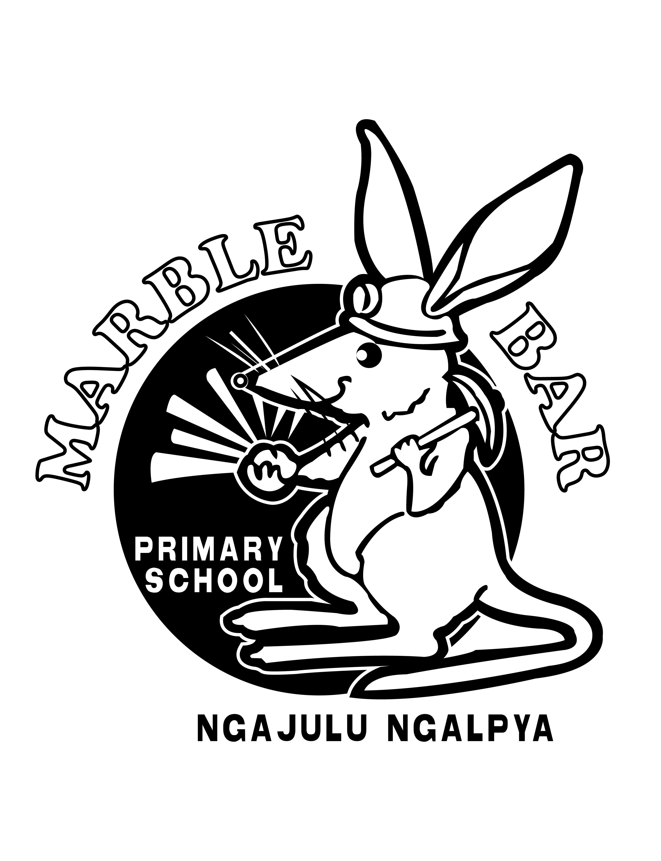
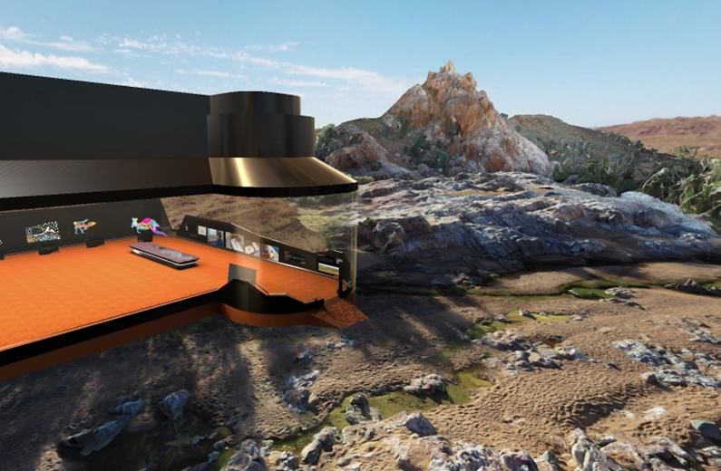
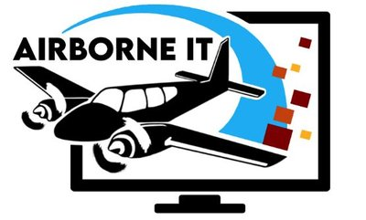
Marble bar virtual worlds
Working Together
Warrkamu Yikamartala

Slide 2
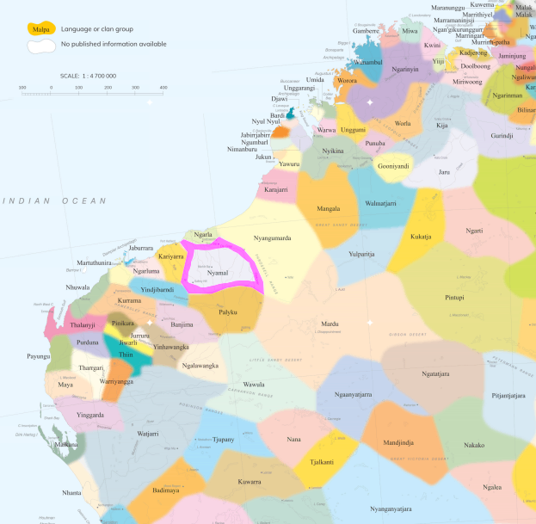
where is marble bar?
Working Together
Warrkamu Yikamartala

Slide 3
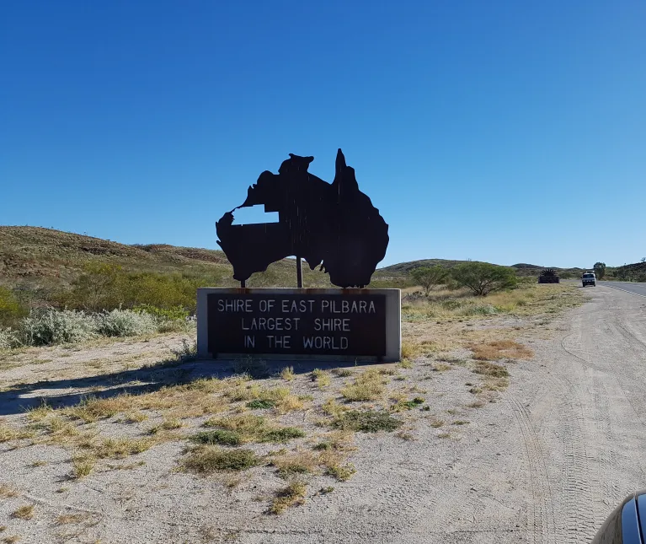
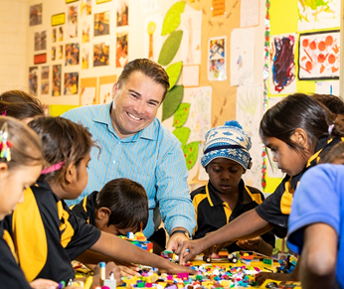
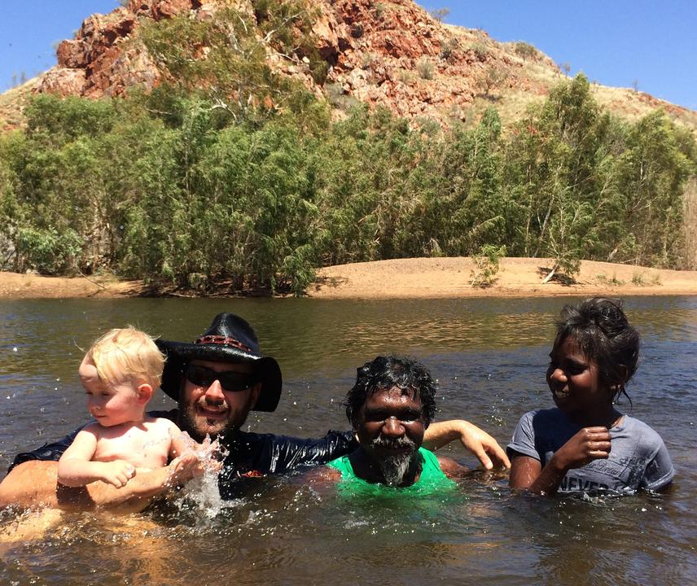
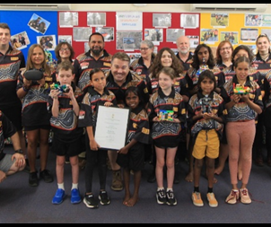
why was the project initialised?
Working Together
Warrkamu Yikamartala

Slide 4
Closing the Digital divide

Slide 5
Showcasing Nyamal culture in a virtual gallery

Slide 6
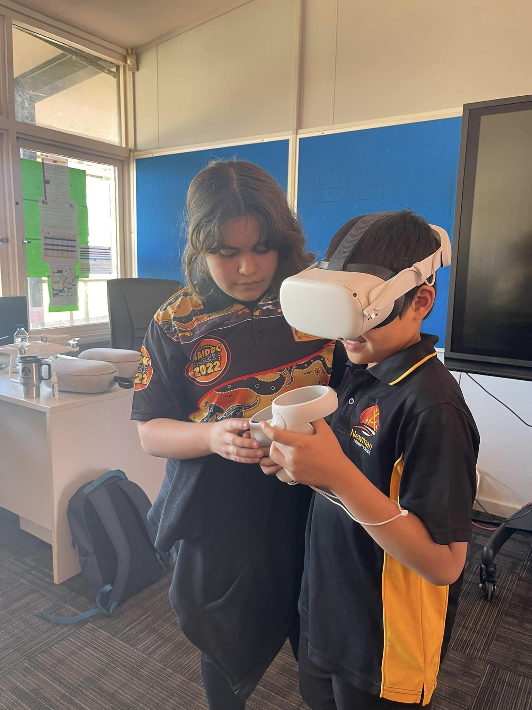
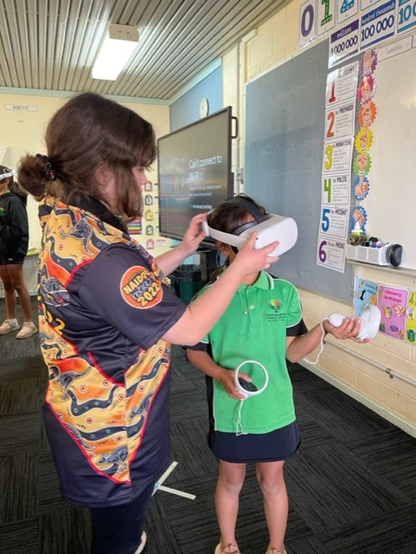
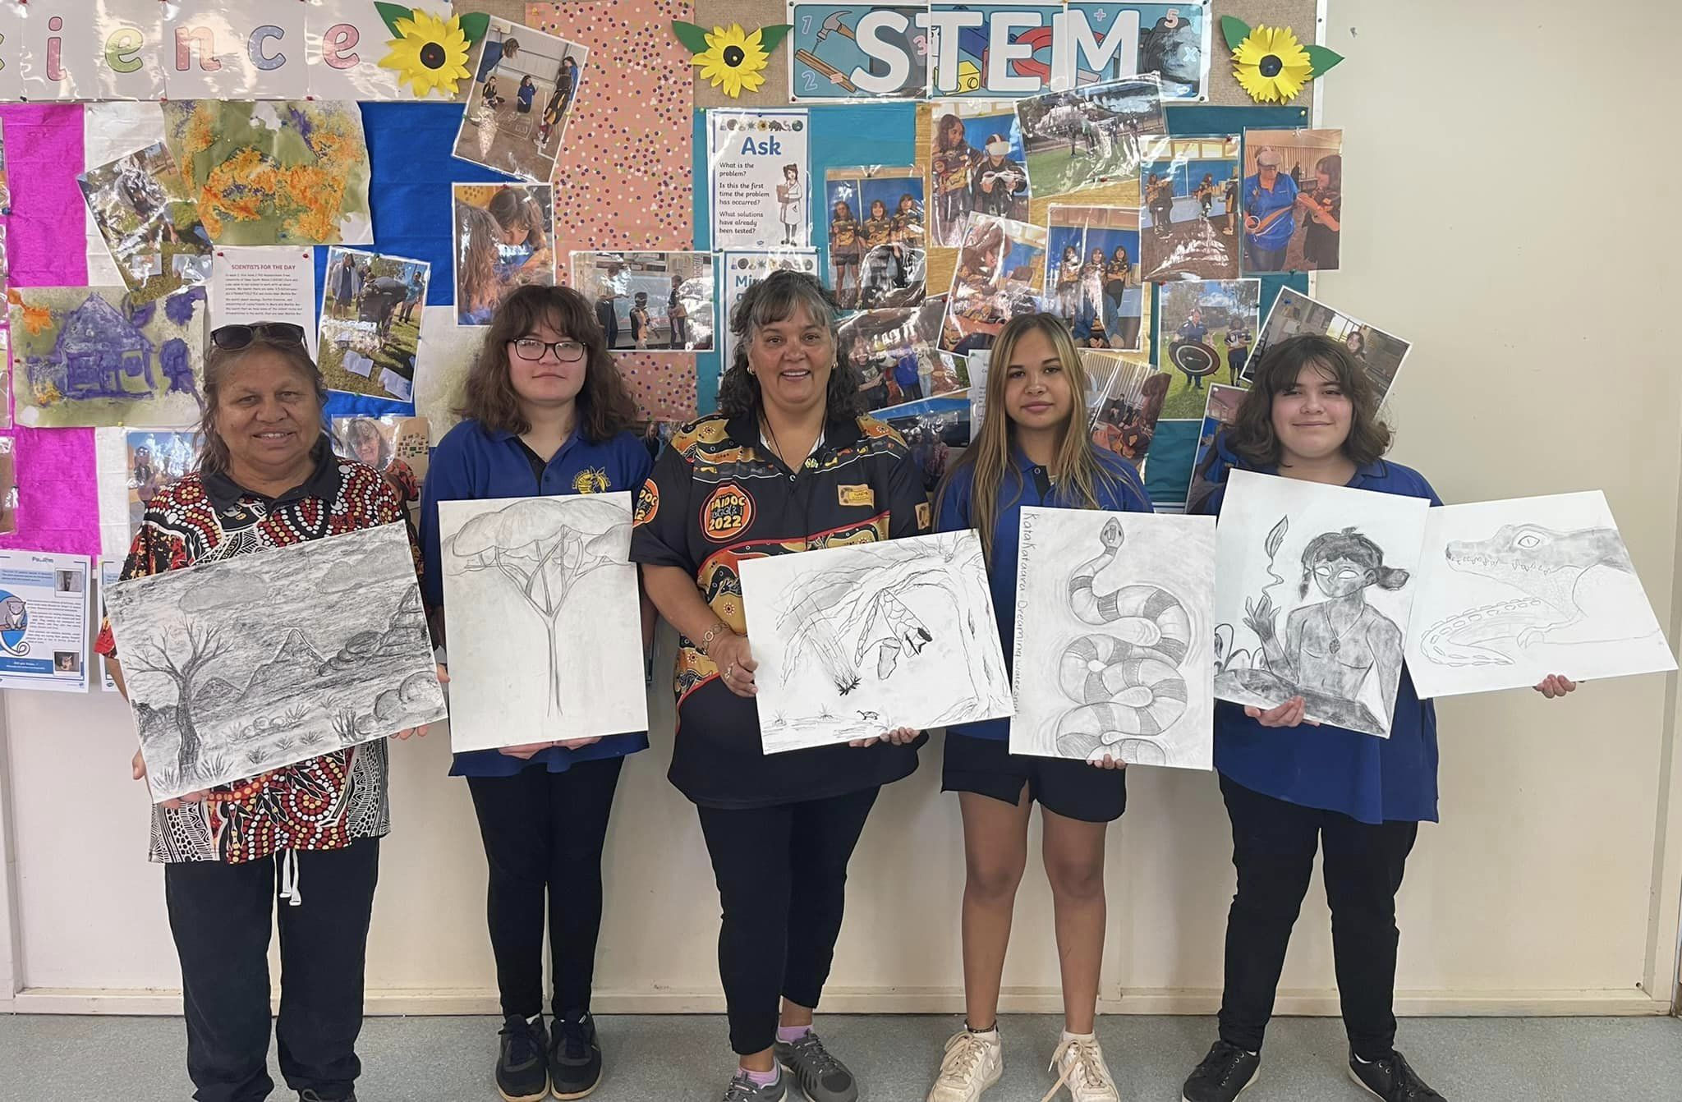
integrating the virtual worlds into the health learning area
Mental Health
The Virtual World enables students to connect with each other, in person and virtually.
Cross-Curricular Initiatives
Can be integrated into literacy, numeracy, health and well-being.
Physical Health
Integrated Skill Development
Professional Development
Creativity, communication, digital technologies, problem-solving and teamwork.
Knowledge of health concepts can be represented as objects, integrated into Virtual Worlds using, for example, Tiltbrush by Google.
The Virtual Teacher Development Centre enables educators to connect and learn from each other.

Slide 7
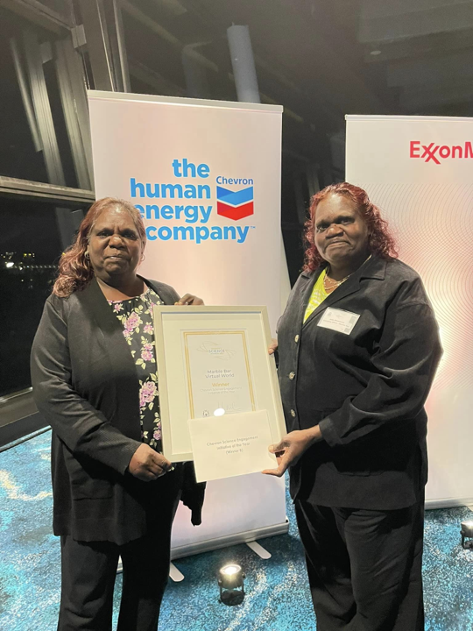
Feedback & Impact:
"It has been great to see my kids and their fellow students going through an engaging and hands-on educational journey to create these amazing pieces of work. This initiative has sparked curiosity and passion amongst our students while also encouraging learning about our rich Aboriginal culture and history“. (Julie Whalebone, Nyamal Elder).

